Slide 1
Revisited-Graph data Structure

Slide 2
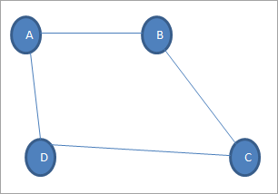
Graph Terminology
Vertex: Each node of the graph is called a vertex. In the above graph, A, B, C, and D are the vertices of the graph.
Edge: The link or path between two vertices is called an edge. It connects two or more vertices. The different edges in the above graph are AB, BC, AD, and DC.
Adjacent node: In a graph, if two nodes are connected by an edge then they are called adjacent nodes or neighbors. In the above graph, vertices A and B are connected by edge AB. Thus A and B are adjacent nodes.
Degree of the node: The number of edges that are connected to a particular node is called the degree of the node. In the above graph, node A has a degree 2.
Path: The sequence of nodes that we need to follow when we have to travel from one vertex to another in a graph is called the path. In our example graph, if we need to go from node A to C, then the path would be A->B->C.
Cycle: A path in which there are no repeated edges or vertices and the first and last vertices are the same is called a cycle. In the above graph, A->B->C->D->A is a cycle.
Complete Graph: A graph in which each node is connected to another is called the Complete graph. If N is the total number of nodes in a graph then the complete graph contains N(N-1)/2 number of edges.
Weighted graph: A positive value assigned to each edge indicating its length (distance between the vertices connected by an edge) is called weight. The graph containing weighted edges is called a weighted graph. The weight of an edge e is denoted by w(e) and it indicates the cost of traversing an edge.
Diagraph: A digraph is a graph in which every edge is associated with a specific direction and the traversal can be done in specified direction only.

Slide 3
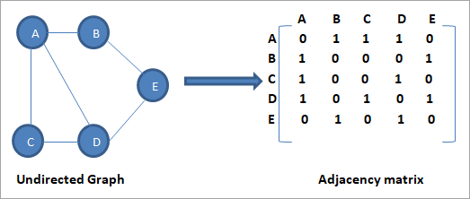
Graph Representation
Sequential Representation
In the sequential representation of graphs, we use the adjacency matrix. An adjacency matrix is a matrix of size n x n where n is the number of vertices in the graph.
The rows and columns of the adjacency matrix represent the vertices in a graph. The matrix element is set to 1 when there is an edge present between the vertices. If the edge is not present then the element is set to 0.
Note that since this is an undirected graph, and we can say that the edge is present in both directions. For Example, as edge AB is present, we can conclude that edge BA is also present.

Slide 4
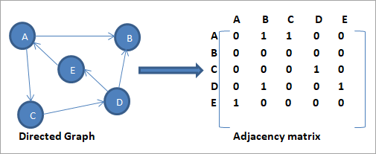
adjacency matrix of a directed graph.
the intersection element in the adjacency matrix will be 1 if and only if there is an edge directed from one vertex to another.
In the above graph, we have two edges from vertex A. One edge terminates into vertex B while the second one terminates into vertex C. Thus in adjacency matrix the intersection of A & B is set to 1 as the intersection of A & C.

Slide 5
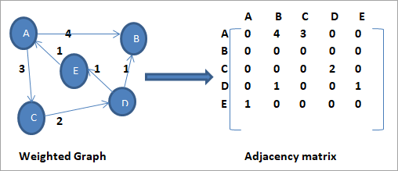
the weighted graph and its corresponding adjacency matrix.
the sequential representation of a weighted graph is different from the other types of graphs. Here, the non-zero values in the adjacency matrix are replaced by the actual weight of the edge.
The edge AB has weight = 4, thus in the adjacency matrix, we set the intersection of A and B to 4. Similarly, all the other non-zero values are changed to their respective weights.

Slide 6
adjacency matrix.
There are |V| rows and |V| columns in an adjacency matrix, and so the matrix has |V| ² entries
This is space inefficient for sparse graphs

Slide 7
Concept of Sparse & Dense Matrix
Matrices that contain mostly zero values are called sparse, distinct from matrices where most of the values are non-zero, called dense.
Dense graph is a graph in which the number of edges is close to the maximal number of edges. (Complete Graph)
Sparse graph is a graph in which the number of edges is close to the minimal number of edges. Sparse graph can be a disconnected graph.

Slide 8
Linked Representation
We use the adjacency list for the linked representation of the graph. The adjacency list representation maintains each node of the graph and a link to the nodes that are adjacent to this node. When we traverse all the adjacent nodes, we set the next pointer to null at the end of the list.

Slide 9
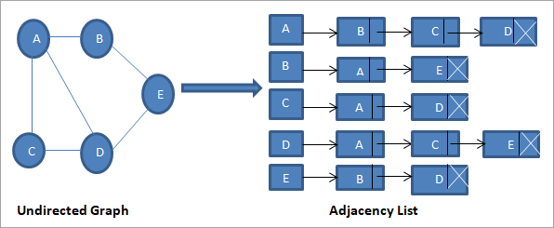
undirected graph and its adjacency list.
we have a linked list (adjacency list) for each node. From vertex A, we have edges to vertices B, C and D. Thus these nodes are linked to node A in the corresponding adjacency list.

Slide 10
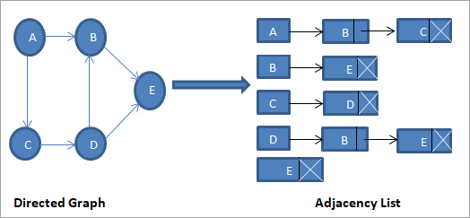
adjacency list for the directed graph.
we see that there are no edges originating from vertex E. Hence the adjacency list for vertex E is empty.

Slide 11
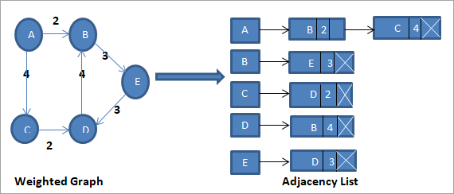
adjacency list for the weighted graph.
For a weighted graph, we add an extra field in the adjacency list node to denote the weight of the edge as shown in figure.
Adding vertex in the adjacency list is easier. It also saves space due to the linked list implementation. When we need to find out if there is an edge between one vertex to another, the operation is not efficient

Slide 12
adjacency list
Using an adjacency list representation, each edge in a directed graph is represented by one item in one list; and there are as many lists as there are vertices
Therefore the storage required is proportional to |V| + |E|, which is much better than |V| ² for sparse graphs, and comparable to |V| ² for dense graphs

Slide 13
Adjacency matrix vs. adjacency list representation
Adjacency matrix
Good for dense graphs --|E|~O(|V|²)
Connectivity between two vertices can be tested quickly
Adjacency list
Good for sparse graphs -- |E|~O(|V|)
Vertices adjacent to another vertex can be found quickly

Slide 14
Basic Operations For Graphs
Following are the basic operations that we can perform on the graph data structure:
Add a vertex: Adds vertex to the graph.
Add an edge: Adds an edge between the two vertices of a graph.
Display the graph vertices: Display the vertices of a graph.

Slide 15
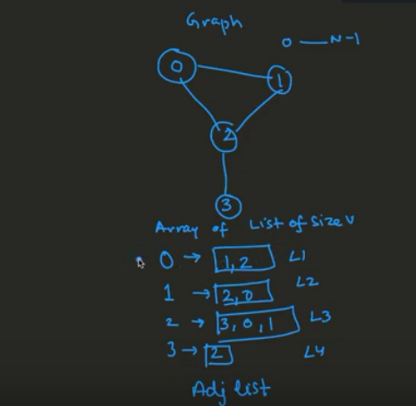
Graph DS Implementation –Adjacency List

Slide 16
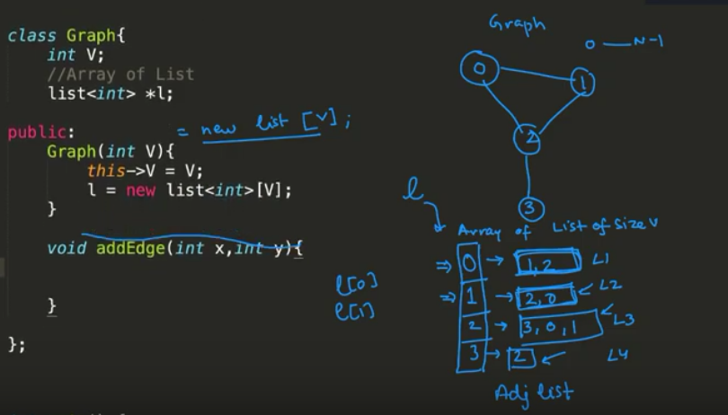

Slide 17
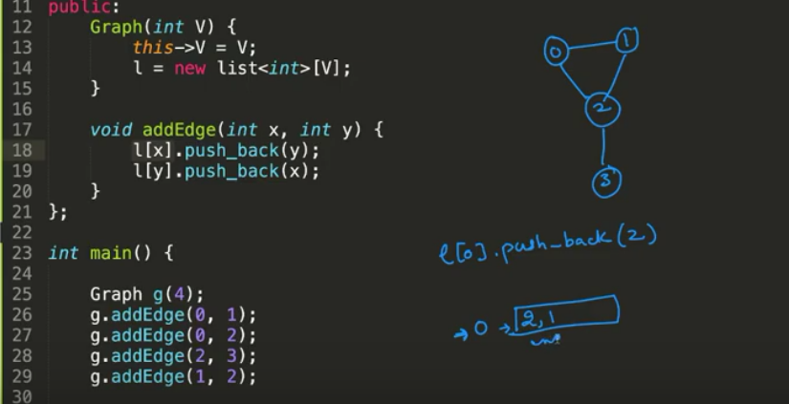

Slide 18
Task:
Implement:
Graph DS by using Adjacency Matrix
DFS & BFS Algorithms

